Slide 1
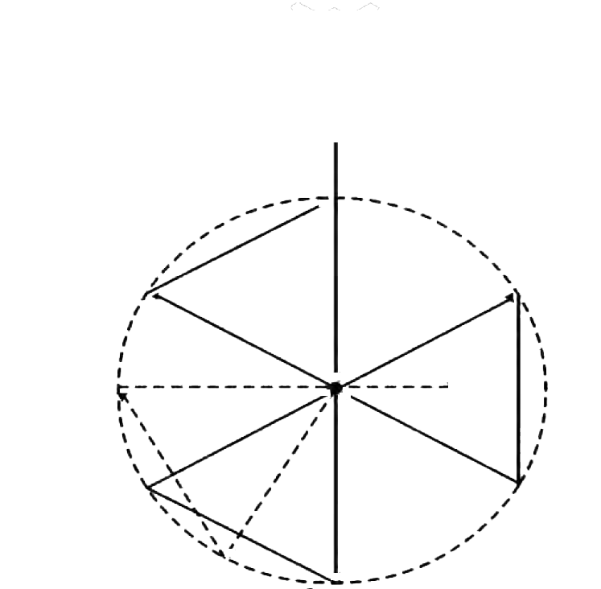
First Search
Second Search
30°

